Slide 1
Securing Smart Home Automation Network using Cisco Packet Tracer
Done by
Visakh Pradeep (21BLC1078)
Fawaaz S (21BLC1245)

Slide 2
Motivation
Over the past few years, home automation has become more popular.
IoT is a constantly developing technology, there are now smarter and more sophisticated solutions in the field of home automation. The appliances must be completely automated without any user involvement of any kind in order to raise the standard of living.
Due to recent security breaches in many homes, home security is now a need. Therefore it is necessary to implement various security measures in the home network so as to live a secure life at home.

Slide 3
Objective
The project is on designing and implementing a home automation system using Cisco Packet Tracer and enhancing it’s security using various methods.
Packet tracer is being utilized to create a system that integrates various devices like sensors and actuators to enhance home comfort, convenience, energy efficiency, and security.
The system aims to automate various tasks and improve convenience, comfort, and energy efficiency within a home along with being secured from unauthorized access.

Slide 4
Proposed methodology
We will use different IoT based systems like fans, doors, smoke detector, humidity monitor, smart lamps, fire sprinklers and alarms to create a virtual IoT implemented home in Cisco Packet Tracer
A Home Gateway will be configured to control (automate) all the IoT devices used in the home network.
We will then connect the Home IoT system with a Mobile Tower Network so that a smartphone connected to the mobile tower can be used to configure the IoT devices

Slide 5
Block diagram
Fan/Lamps
Sensors
PCs
Actuators
Smartphone
Sensors
HOME GATEWAY
CABLE MODEM
Actuators
Cloud
Fire Detector
ISP
Sprinkler
DNS
TOWER
IoT

Slide 6
Contribution
Visakh Pradeep – Creating the Presentation, Choosing end devices and implementing it into the network and configuring gateway with conditions
Fawaaz S –Setting up ISP, DNS, IoT Servers and configuring it with Home Gateway and Mobile Tower. Demo video creation.

Slide 7
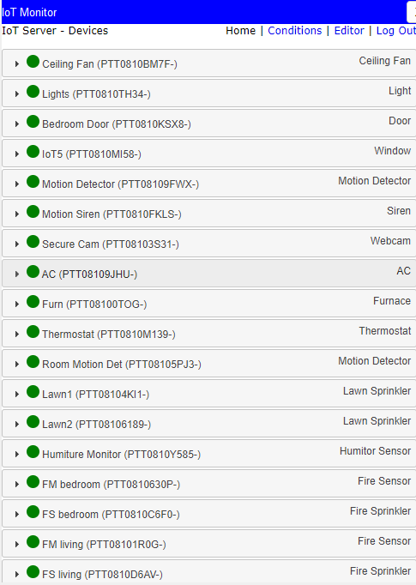
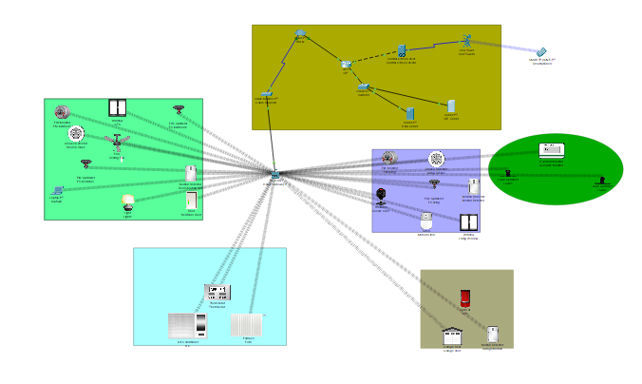
Output Screenshots

Slide 8
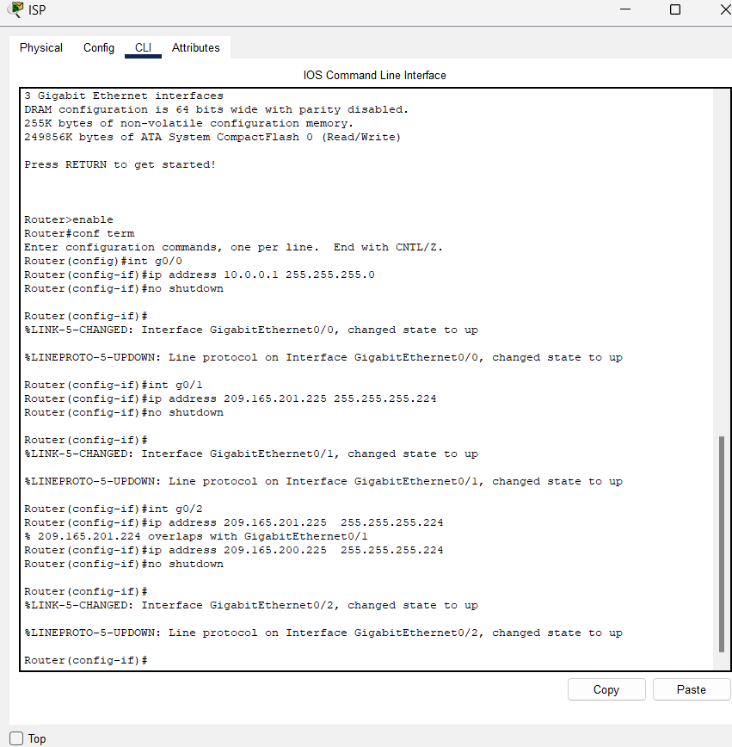
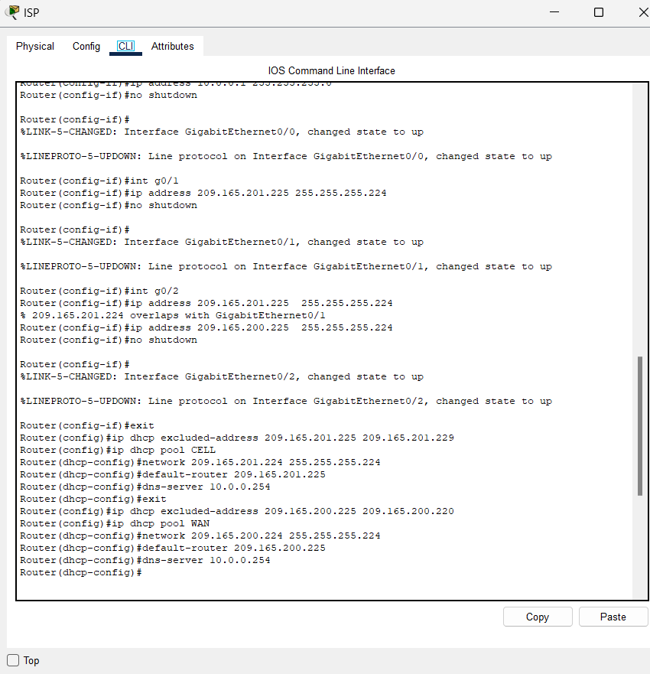
ISP SETUP

Slide 9
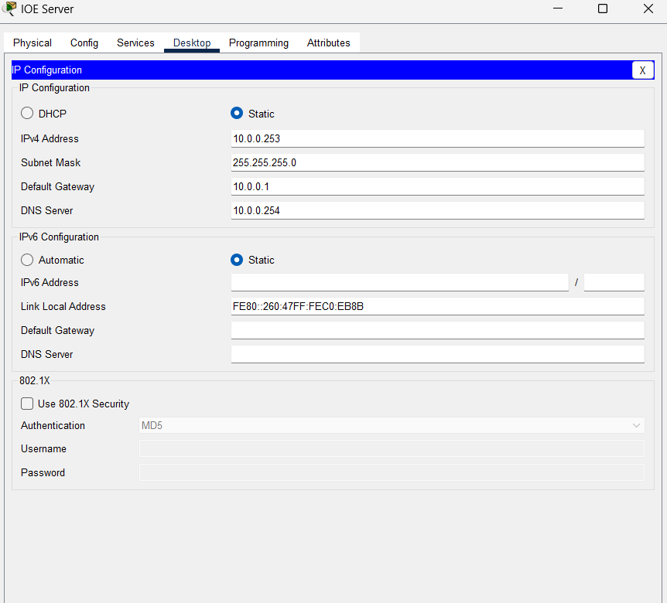
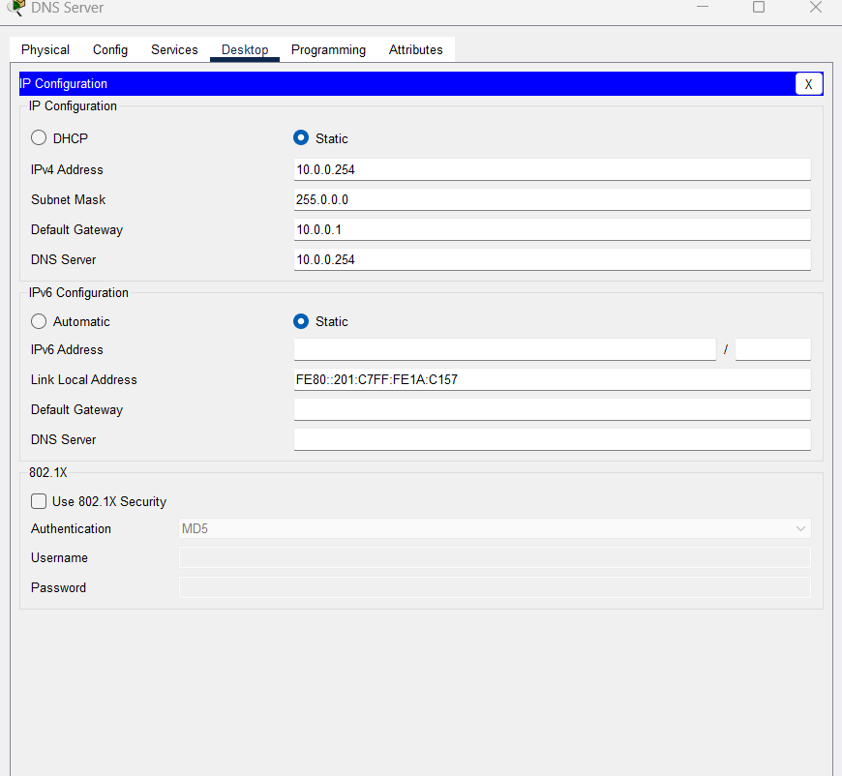
IOT SERVER SETUP DNS SERVER SETUP

Slide 10
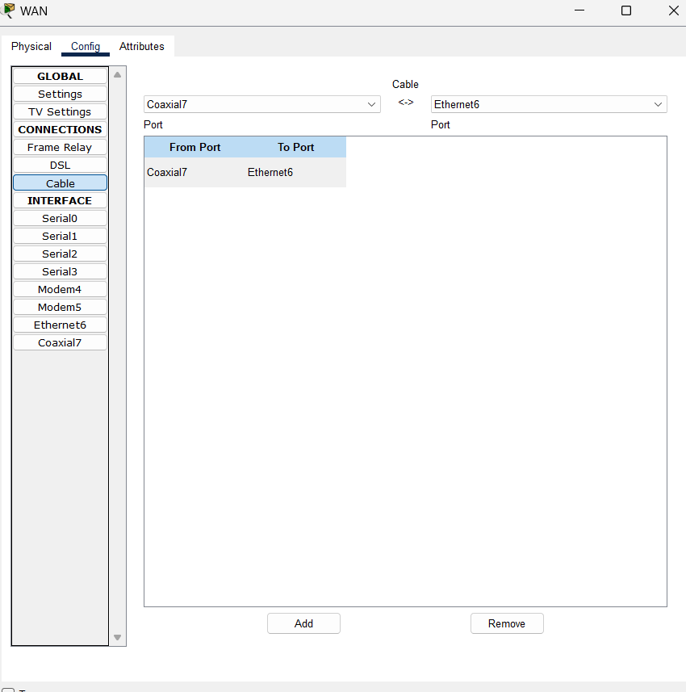
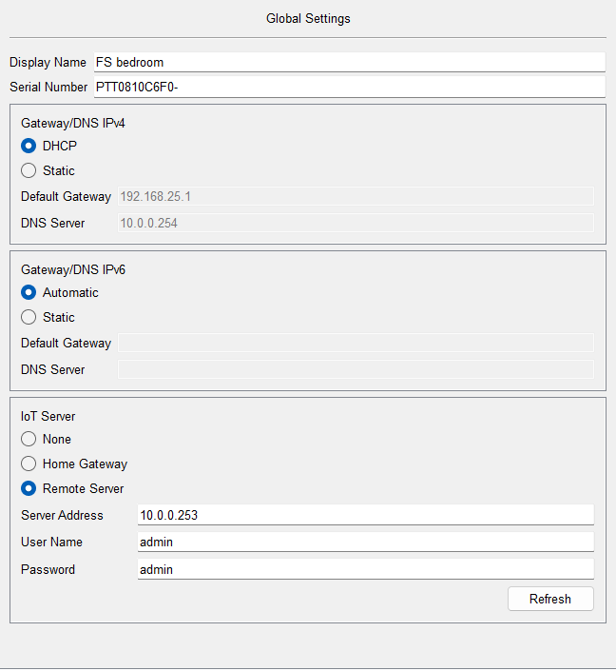
WAN SETUP END NODE SETUP

